Slide 1
Parallel Horace. Design ideas
User requests:
User works in parallel and non-parallel mode the same way, switching from
one to another issuing a simple command (e.g. >>hpc on) or
providing simple option (e.g. –parlallel)
Horace works on any machine or cluster and with or without parallel
computing toolbox and distributed computing server
There is limited number of algorithms benefited from parallelization,
namely gen_sqw, cut_sqw, unit and binary operations tobyfig.fit,
sqw_eval and symmetrise

Slide 2
Horace Algorithms: common feature and simplification:
Time-consuming operation
Small interprocess communications
For i=1:N_iterations
Results(i) = Do_processing(Data,i)
End
summary = reduce_results_process_condition(Data,Results)
return summary
Exceptions with possibility of high interprocess communications:
combine_tmp
read/write hdf
may be binary operations – reduces to combine_tmp:

Slide 3
Matlab parallel toolbox capabilities: (Herbert poor man MPI)
Starts Matlab sessions (from Java) running worker scripts
cl = ClusterHerbert(n_workers,mess_exchange_framework)
cl.start_job(‘JobClassName’,list_of_jobs_parameters)
cl.collect results
Tasks distributed to workers as mat message files
Results returned to the user node as mat message files

Slide 4
Matlab MPI capabilities (toolbox or cluster):
Unix MPI job:
>> mpiexec n_workers the_mpi_program
Tasks distributed to workers as mat files
Matlab Way:
cl = parcluster(n_workers);
cjob = createCommunicatingJob(cl,'Type','SPMD');
task = createTask(cjob,UserFunctionHandle ,0,{user_function_inputs});
submit(cjob)
cjob.return_results
Results returned to the user node as mat files

Slide 5
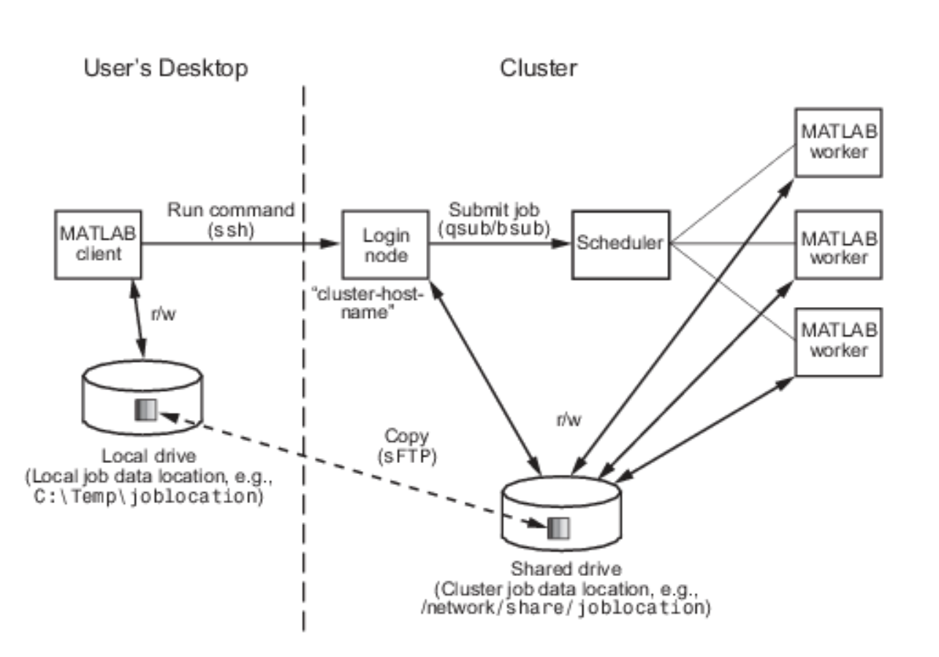
Matlab distributed computing cluster. Available configuration:
System dependent?
Big data

Slide 6
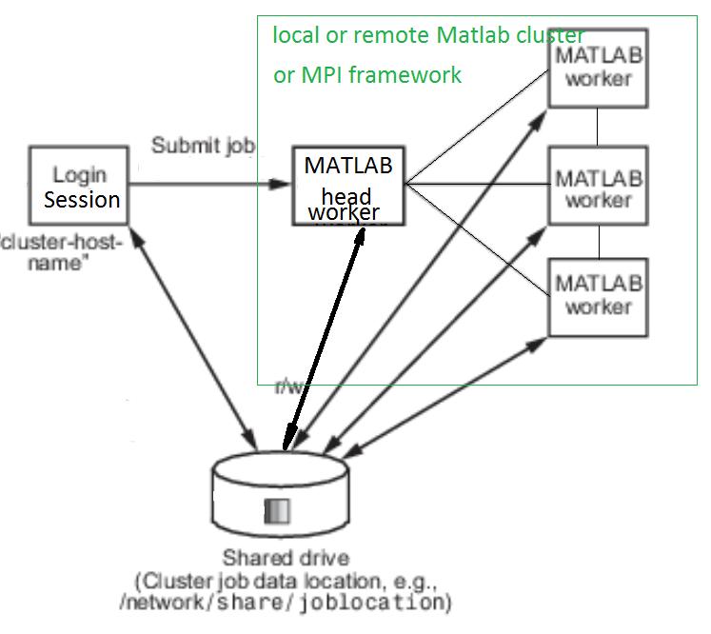
Simplified Herbert/Matlab cluster implemented:

Slide 7
Message exchange framework:
Currently a Matlab class, with methods:
send_message, (asynchronous, non-blocking)
receive_message, (synchronous, blocking)
probe_message (asynchronous, non-blocking)
Two instances:
filebased messages
Matlab MPI messages (wrapper around Matlab MPI)

Slide 8
Parallel extensions operation diagram:
Matlab Worker1 (headnode)
FB message
exchange
run worker_v1 script
User’s Matlab session
Je = feval(JobExecutor )
start
Jd = JobDispatcher()
Je.do_job()
Job info
Je.report progress)
Jd. start_job
Progress info
Je.return_results
Jd. log_progress
Worker …….
MPI/FB message
exchange
Results
Matlab Worker N
Matlab Worker N
Result=Jd. get_results
run worker_v1 script, wait for job info
run worker_v1 script
Je = feval(JobExecutor )
Je = feval(JobExecutor )
Je.do_job()
Je.do_job()
Je.report progress)
Je.report progress)
Je.return_results
Je.return_results

Slide 9
Challenges:
C++ “cluster” running Matlab workers (MPI job)
A “cluster” running compiled Matlab code
Parallel write opportunities. Parallel read from hdf.

